Slide 1
Coupa Supplier Portal (CSP) Training

Slide 2
07
How to View Purchase Orders

Slide 3
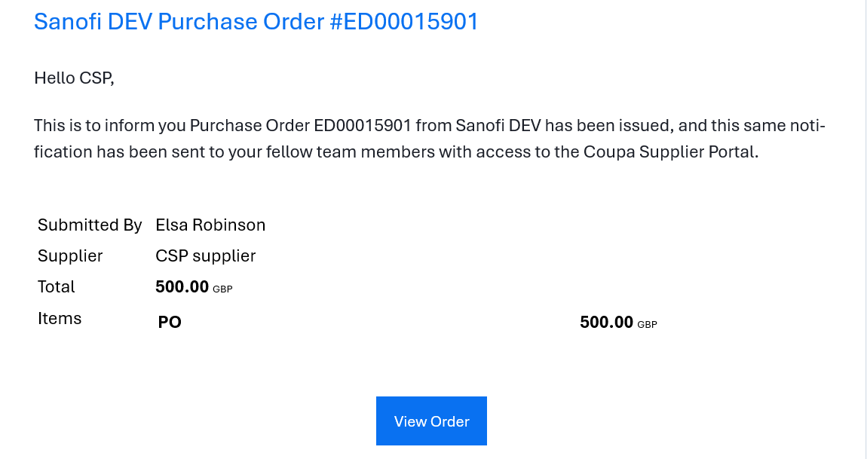
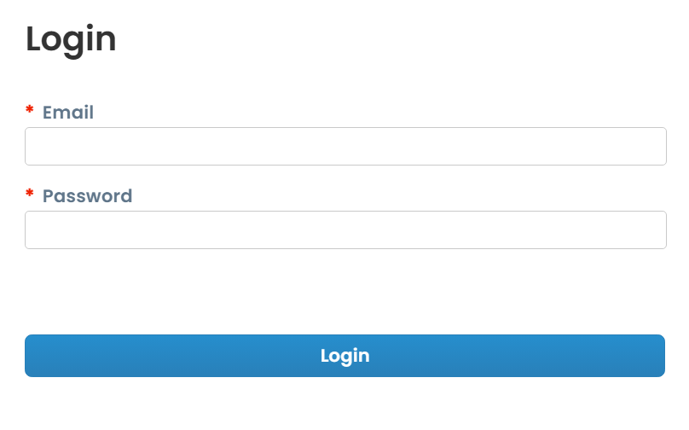
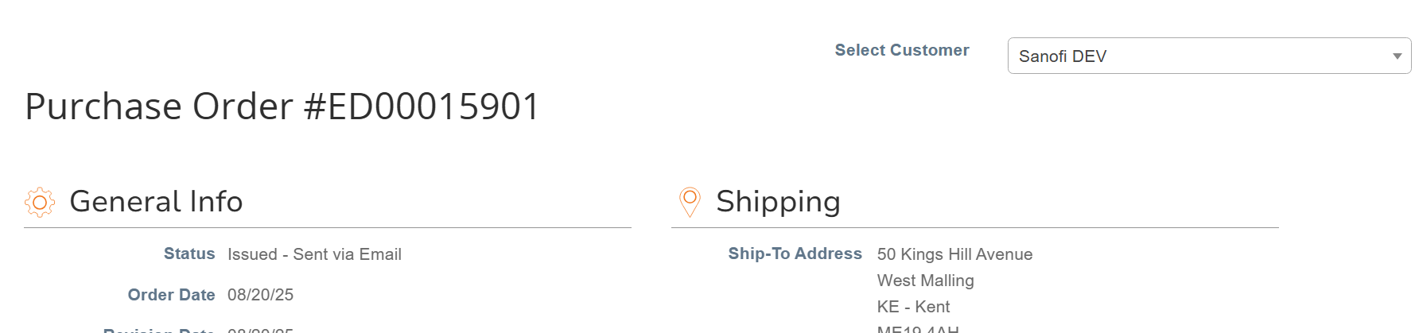
EXAMPLE
How to View Purchase Orders – Email Notification
1
How to View Purchase Orders – Email Notification
You will receive an email notification informing you that you have received a PO.
The email will contain the POs basic information, to view the PO details in full click on the “View Order” button
You will then be taken to the CSP sign in page, log in using your username and password
You will then be automatically taken to the PO page where you can see all the purchase order details*
2
3
4
*Note: You are also able to create an invoice from this page, this is covered in more detail in the ‘How to Submit Invoices’ section.

Slide 4
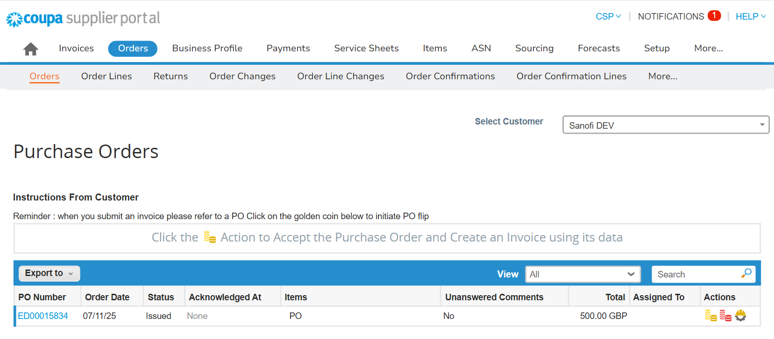
EXAMPLE
How to View Purchase Orders – Orders Tab (1/2)
1
How to View Purchase Orders – Orders Tab (1/2)
To view your PO in CSP, login to your CSP account:
Select the “Orders” tab
Under the “Orders” sub-tab, use the search bar to search for the PO
If you are unable to see your purchase order, make sure you have selected the correct customer from the “Select Customer” drop-down in the top right-hand corner
To view the purchase order details in full click on the link in the PO Number column*
To view purchase orders with specific criteria, use the ‘Views’ dropdown menu to select an existing view or create your own custom view
3
5
2
4
*Note: You are also able to create an invoice using the gold coins icon in the “Actions” column, this is covered in more detail in the “How to submit an invoice” section.

Slide 5
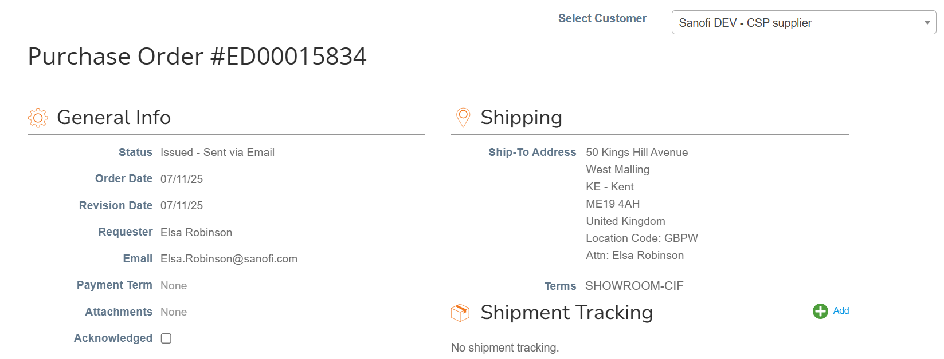
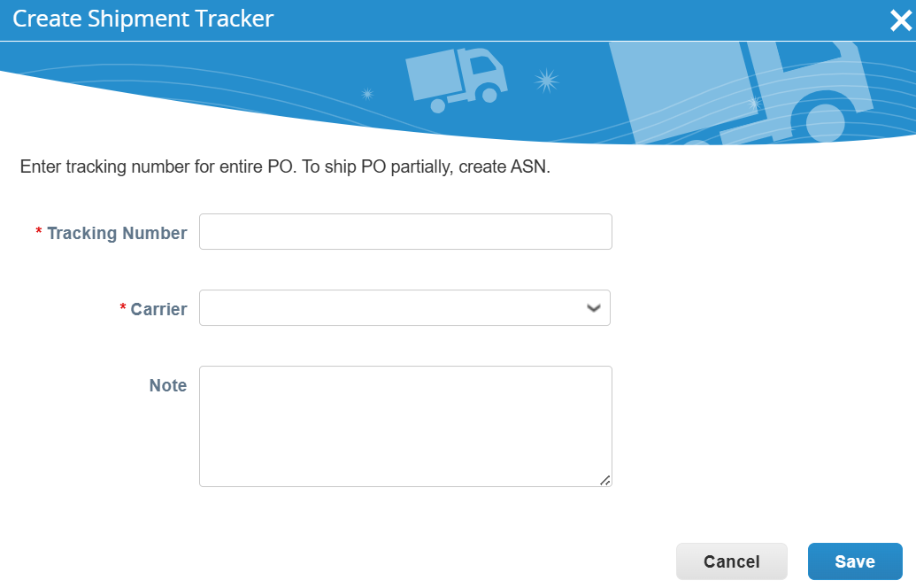
EXAMPLE
How to View Purchase Orders – Orders Tab (2/2)
How to View Purchase Orders – Orders Tab (2/2)
On the PO page, you will be able to:
Acknowledge the PO by selecting the “Acknowledged” checkbox
Add the shipment tracking details (e.g. “Tracking Number” and “Carrier”) by clicking the green plus button in the “Shipment Tracking” section
7
6
*Note: You are also able to create an invoice using the “Create Invoice” button at the bottom of the PO page, this is covered in more detail in the “How to submit an invoice” section.

